Slide 1

3D Printing
TGC TECHNOLOGY &
Present:
By T.Cowles
This Slideshow is released under the creative commons license. Available for download from maker.tgctech.org. You are free to use this however you want as long as any modifications are also released under the creative commons and this credits page remains unaltered
Notes:
All speaker notes will be down here. Don’t expect them to be spell checked, I am making these for use by me, if they help you and you want to fork this project with a spell checked version then feel free to.
© 2018

Slide 2
Before Building the Printer
Before we start to build our Ender 3 3D printer kit we should understand how a 3D printer works. There are a few key components that we will cover
-Stepper motors and stepper drivers
-Ramps 1.4
-Marlin

Slide 3
Stepper Motors
Stepper motors are key to 3D printers allowing easily controlled precise movements.
Great Scott -Stepper Motors and Drivers (Electronics 101)

Slide 4
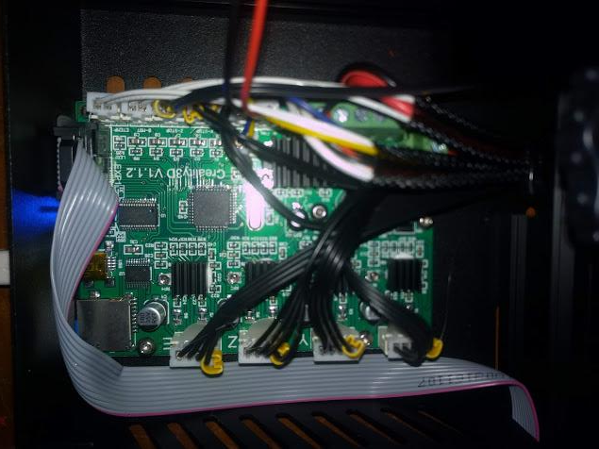
Ramps 1.4
Mosfets
Arduino Mega Core
Stepper Drivers
relay
Notes:
The ramps 1.4 board is the board that most 3D printers, including this kit, are based on. The ramps 1.4 comes in a wide range of shapes sizes and feature sets due to it’s open source nature. but they all use an 8 bit arduino mega compatable CPU at their core making them easily programmable and highly modular. There are a few important parts on the ramps 1.4 that we must cover. The stepper drivers which we saw in the last video, the mosfets are high power transistors (a transistor is a switch) that are used with a PID loop to control the temp of the hotend and heated build platform,

Slide 5
BUILDING!
Instructions available at https://github.com/TGC-TECH/3D-Printer-Class/blob/master/ender%203%20assembly.pdf

Slide 6
Flashing Firmware
Video instructions
TH3D Firmware + Bootloader and firmware flashing tool
Stock Firmware
Notes:
We will install the arduino bootloader to make it far easier to flash modified firmwares to the printer at a later date, this will allow for us to enable mesh bed leveling, dual extruders, and just generally make it easier to install updates, becasuse flashing the bootloader will wipe the stock firmware I Highly recommend that we flash TH3D because TH3D has been modified to include additional safety measures for thermal protection, but we can also reflash the stock firmware

Slide 7
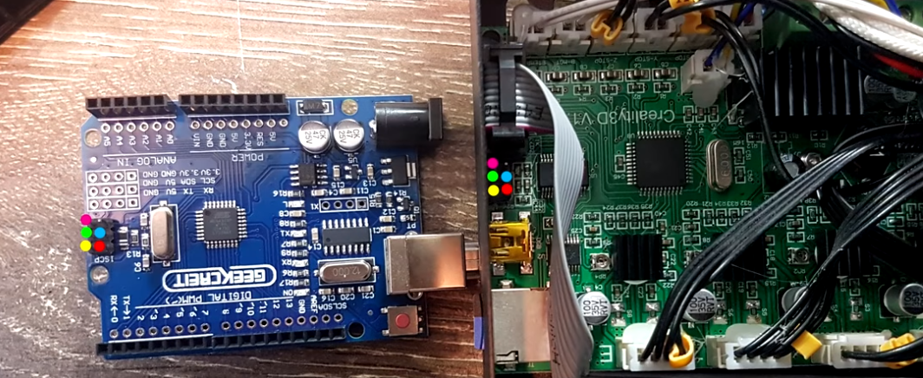
Wiring diagram

Slide 8
let’s mod our printer!
Open the Arduino IDE bundled with TH3D that you just downloaded
From the Tools menu, select Board and then chose your board type (Arduino/Genuino UNO in my case)
From the Tools menu, select the port your Arduino is connected to (COM5 in my case)
From the File menu, select Examples > ArduinoISP > ArduinoISP
Select Upload (Sketch > Upload or the small right facing arrow on the toolbar)
Notes:
These printers are based around an ATMEGA CPU, the same type used in the Arduino Mega, however these are missing the arduino bootloader that allows us to easily flash modified firmwares over USB. In order to install the arduino boot loader we must use an arduino uno.

Slide 9
Modding continued
Once everything is wired up correctly, connect the Ender 3 to your PC via USB.
Now you can plug your Arduino board into the PC via USB as well.
Open the Arduino IDE and from the Tools Menu select Board > Sanguino
Select Tools > Processor > ATmega1284P 16Mhz
Select Tools > Port and choose the port for the Arduino board (NOT the Ender)
Select Tools > Programmer > Arduino as ISP
Finally, Select Tools > Burn Bootloader

Slide 10
Reflashing firmware!
Exit the Arduinoisp sketch and return to the TH3D sketch, make sure you have enabled ‘ender 3’ in the configuration.h tab
Set your Programmer to AVRISP mkII (Tools > Programmer).
Click the arrow to upload the firmware!

Slide 11
Printing (slicing and designing)

Slide 12
Test print
Before we start working on our own designs we must print a test print. To assure our printer is properly leveled and calibrated.
We will use a pre sliced model that you can download at the link below.
https://github.com/TGC-TECH/3D-Printer-Class/tree/master/Pre%20Sliced%20models
I will help everyone make sure that there printer is leveled and printing well. Once everyone’s printer is printing we can begin 123D which will be continued on day 2

Slide 13
Start of day 2

Slide 14
Live 123D demo
Please download 123D from 123d.tgctech.org. once the program is installed we will begin learning the fundamentals of CAD
(in case anyone wants to know the official 123D downloads have been gone for a while but it is still one of the best primitive based modeling software so I am hosting mirrors, all of these mirrors are from installers downloaded either directly from Autodesk, who is the actual maker of the software, or from archive.org which up until recently had downloadable copies)
Notes:
Primitive based modeling software works by combining, subtracting and cutting “PRIMITIVES” which are basic 3D shapes such as cubes, cylinders, spheres, etc. 123D primarily uses primitives but it also supports some basic sketch based modeling, sketch based modeling uses 2D sketches that can be extruded. Fusion 360 is an example of a popular sketch based modeling software but many people find primitive based software to be more intuitive because of things like Lego, Minecraft, and even introductory cad software that some of you might have experience with such as TinkerCAD

Slide 15
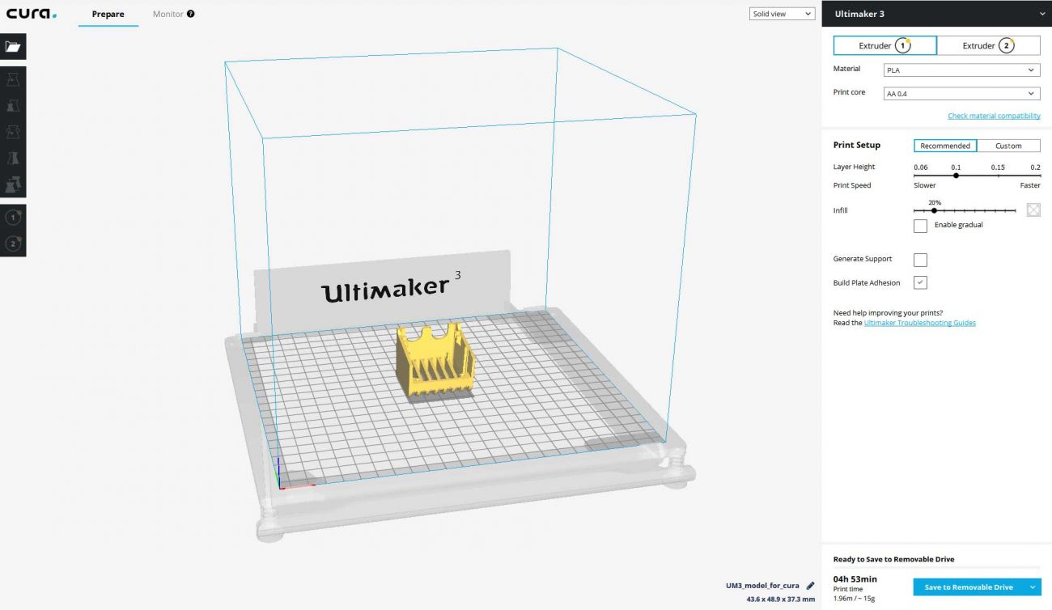
Now that we have created our 3D model we must SLICE IT
Download and install Cura from https://ultimaker.com/en/products/ultimaker-cura-software
Notes:
Slicing is process of generating GCODE (movement instructions) from the stl file exported by 123D. There are several different software solutions available including Slic3r, and repetier host, but in this case we will be using Cura. Cura is an open source slicer with backing from the Ultimaker Company, Cura supports many printers including the CR10 (which is basically an Ender 3) with minimal tuning required.

